Slide 1

GIS Level 2: Introduction to Spatial Analysis
1
Courtesy of US Air Force. Image is in the public domain.

Slide 2
2
OUTLINE
Introduction to spatial analyses
Use map projections & metadata to understand and transform spatial data
Use different types of processing tools in software(s) to perform a multi-step analysis
Exercise new knowledge with GIS software(s)
Introduction » Map Projections » Metadata » Processing Tools » Exercise
Notes:
This workshop is a sampler of the some tools available in ArcGIS Pro or QGIS.

Slide 3
Introduction to Spatial Analysis
3
Introduction » Map Projections » Metadata » Processing Tools » Exercise

Slide 4
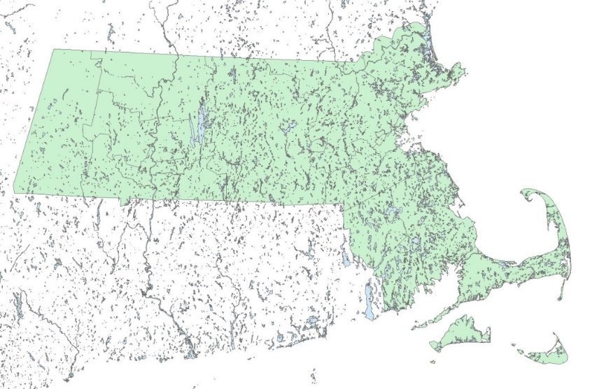
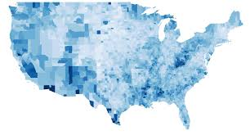
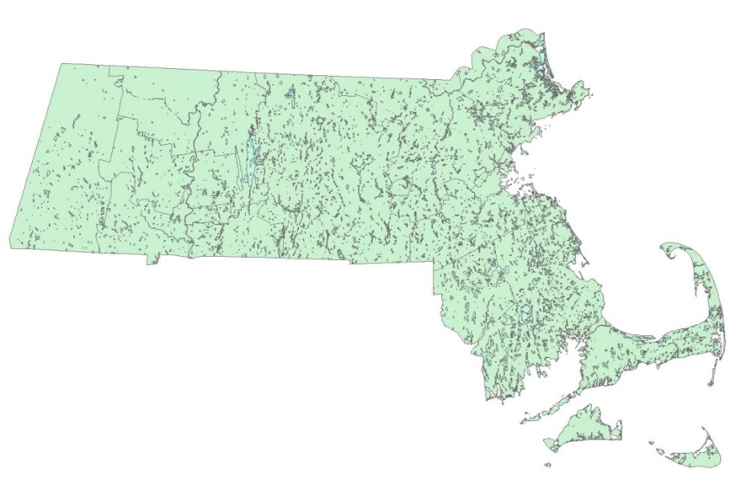
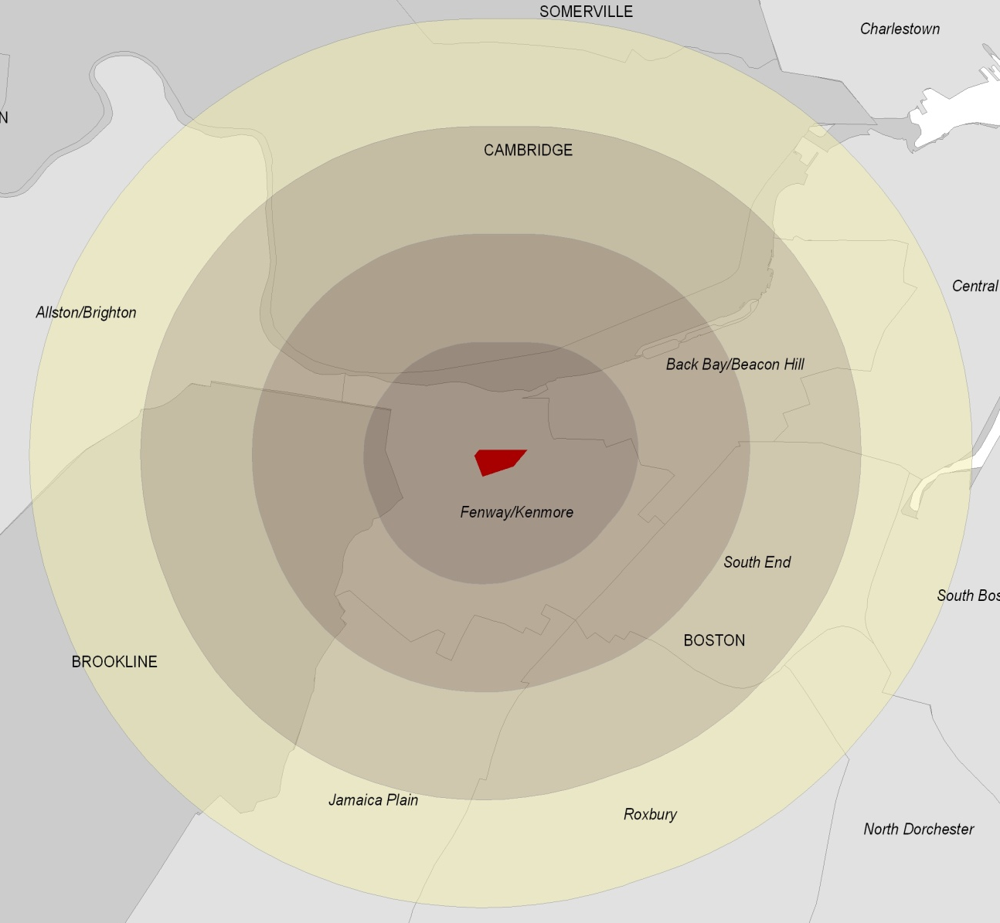
What analyses can you do?
4
Analyze values
(Vectors)
(Rasters)
Edit geometry (Clip tool)
Create data
(Buffer tool)
Images © sources unknown. All rights reserved. This content is excluded from our Creative Commons license. For more information, see https://ocw.mit.edu/help/faq-fair-use/
Introduction » Map Projections » Metadata » Processing Tools » Exercise
Notes:
In this workshop, we will focus on the analysis tools you can use with your data. Analysis tools can be used to edit or subset data (left), analyze data values (top right), and create data (bottom right). A tool may do all of these things at once and you may use several tools in conjunction with one another. Our level 2 workshop goes into these further in this presentation.

Slide 5
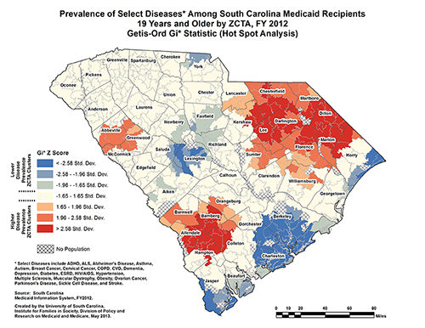
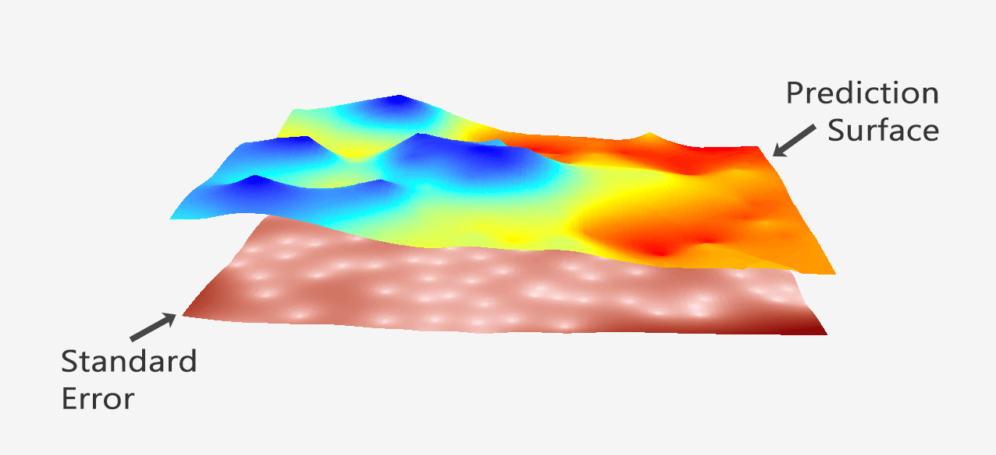
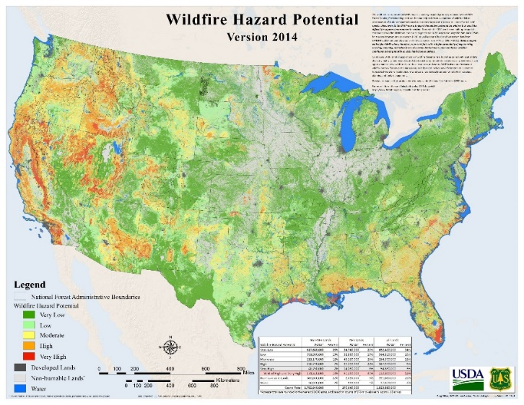
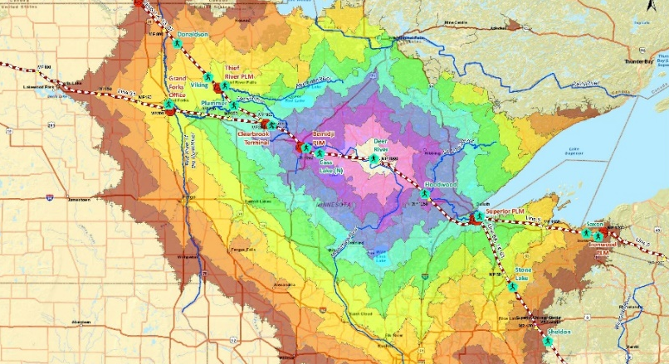
Specialized tools are used to quantify patterns & relationships in your data.
5
Spatial Statistics
Interpolation
Network Analysis
Suitability Analysis
Images © sources unknown. All rights reserved. This content is excluded from our Creative Commons license. For more information, see https://ocw.mit.edu/help/faq-fair-use/
Introduction > Projections > Metadata > Processing Tools > Exercise
Introduction » Map Projections » Metadata » Processing Tools » Exercise
Notes:
Geographic information systems have spatial analysis tools that allow you to quantify patterns and relationships in the data and display the results as maps, tables, and charts. Using tools within a GIS you can examine the attributes and location of spatial data and reveal relationships that you might not be able to see otherwise.
These pictures are examples of some analysis results:
Hot spot analysis of diseases by zip code (spatial stats)
Creating a continuous surface from points (interpolation)
The time it takes to travel from a particular energy source (network analysis)
Wildfire hazard potential (suitability analysis)

Slide 6
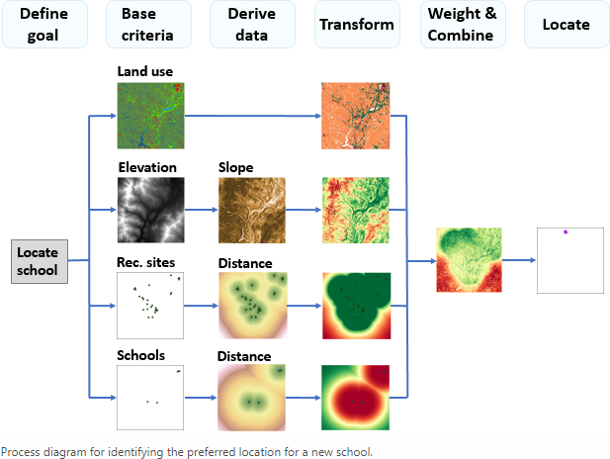
Multiple tools are often used together.
6
Single outputs (raster or vector)
Multiple data inputs
© Esri. All rights reserved. This content is excluded from our Creative Commons license. For more information, see https://ocw.mit.edu/help/faq-fair-use/
Introduction > Projections > Metadata > Processing Tools > Exercise
Introduction » Map Projections » Metadata » Processing Tools » Exercise
Notes:
You will often use multiple tools to answer spatial questions about your data. This is an example of a suitability analysis, a common process done using GIS. It is not a particular set of tools, but rather a way to work with several tools to quantify patters and relationships to determine the best place or site for something.
Suitability example: This shows a suitability analysis for selecting a new school location using: land use, slope, recommended sites, and other school locations.
Source: https://desktop.arcgis.com/en/arcmap/latest/extensions/spatial-analyst/solving-problems/using-the-conceptual-model-to-create-suitability.htm

Slide 7
MAP Projections: Why DO WE care about them?
7
Introduction » Map Projections » Metadata » Processing Tools » Exercise
Notes:
Map projections are especially important when conducting spatial analysis.

Slide 8
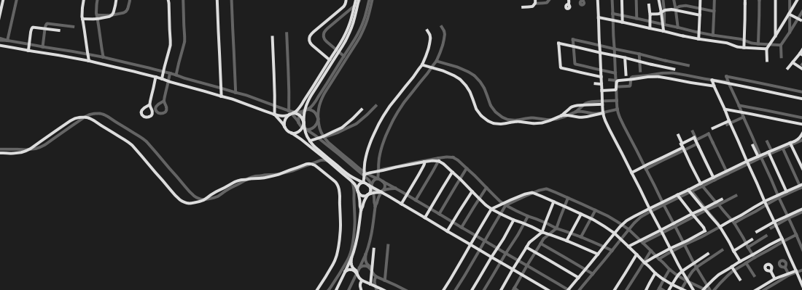
8
If a coordinate system is wrong or missing, data will not display in the correct location.
https://ihatecoordinatesystems.com/
© Dan Mahr. All rights reserved. This content is excluded from our Creative Commons license. For more information, see https://ocw.mit.edu/help/faq-fair-use/
Introduction » Map Projections » Metadata » Processing Tools » Exercise

Slide 9
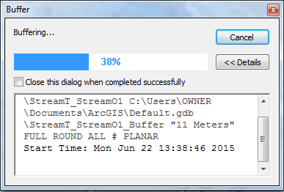
9
Using the same projection for all the datasets in your project will lead to faster processing time.
Introduction > Projections > Metadata > Processing Tools > Exercise
Introduction » Map Projections » Metadata » Processing Tools » Exercise
Analysis >> Projections >> Metadata >> Processing Tools >> Exercise
Notes:
When data are in different projections, tools will convert them into a similar projection during each step of the analysis, which adds time, especially when using multiple data layers or complex tools.

Slide 10
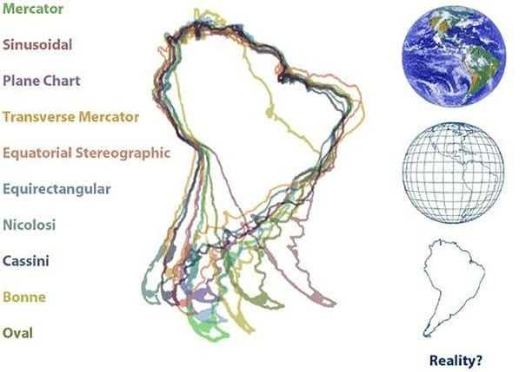
10
Analysis tools that involve shape, area, direction, form, or distance calculations require data to be in a suitable projected coordinate system.
© source unknown. All rights reserved. This content is excluded from our Creative Commons license. For more information, see https://ocw.mit.edu/help/faq-fair-use/
Introduction > Projections > Metadata > Processing Tools > Exercise
Introduction » Map Projections » Metadata » Processing Tools » Exercise
Analysis >> Projections >> Metadata >> Processing Tools >> Exercise
Notes:
Some analysis tools requires that your data be in a projection that uses linear units (meters, feet, etc.) in order to run the tool.

Slide 11
MAP Projections: What are they?
11
Introduction > Projections > Metadata > Processing Tools > Exercise
Introduction » Map Projections » Metadata » Processing Tools » Exercise
Introduction » Map Projections » Metadata » Processing Tools » Exercise
Analysis >> Projections >> Metadata >> Processing Tools >> Exercise

Slide 12
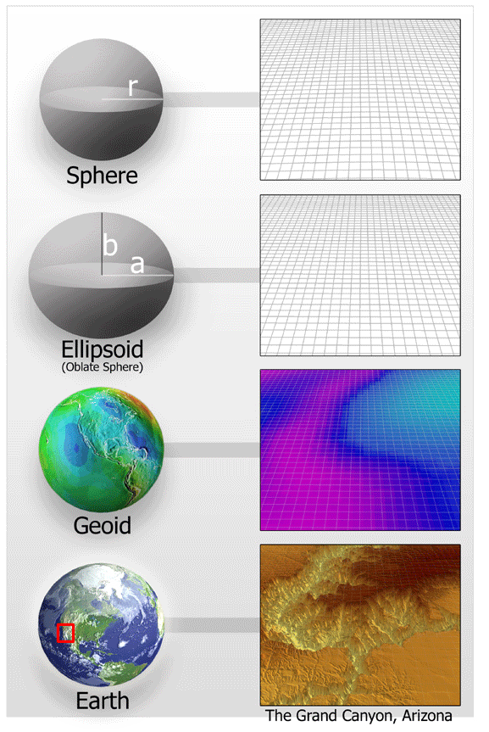
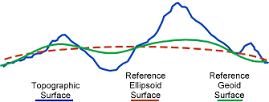
A Datum is an idealized mathematical representation of the Earth.
Sphere Representation
Datum
12
A Geographic Coordinate System (GCS) consists of
Datum
Prime Meridian
Angular Unit
Ellipsoid Representation
Datum
http://desktop.arcgis.com/en/arcmap/latest/map/projections/what-are-map-projections.htm
Courtesy of NOAA. Image is in the public domain.
Introduction > Projections > Metadata > Processing Tools > Exercise
Introduction » Map Projections » Metadata » Processing Tools » Exercise
Introduction » Map Projections » Metadata » Processing Tools » Exercise
Notes:
As you know, geographic data for any particular area are stored in separate layers. For example, roads are stored in one layer, parks in another, and buildings in a third. To enable the data in each layer to integrate when displayed and queried, each layer must reference locations on the earth's surface in a common way. Coordinate systems provide a framework for this to happen.
One type of coordinate system is the geographic coordinate systems. It consists of several parts:
A datum is part of the coordinate system. The earth is not a perfect sphere, although the analysis tools often assume it is, so datums are used to “smooth out” the earth’s surface so it can be more easily analyzed. There are different datums that are designed to be more accurate for different parts of the world. The pictures above show how the imperfect shape of the earth is transformed into a perfect ellipse and then a perfect sphere.
A coordinate system also includes a prime meridian (which specifies the location of 0° longitude) and an angular unit (often degrees).
To use the analysis tools, you often have to make sure the coordinate system is appropriate for your data and the tool you are using.
Sources:
http://www.geo.hunter.cuny.edu/~jochen/gtech201/lectures/lec6concepts/Datums/Basics%20of%20datums.htm
https://www.esri.com/arcgis-blog/products/arcgis-pro/mapping/coordinate-systems-difference/

Slide 13

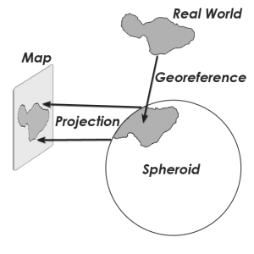
A projection algorithm is applied to the GCS to create a Projected Coordinate System (PCS).
13
Imagine an orange as the Earth, and you want to be able to peel it in such a way as to lay the peel flat.
Similarly, projection is a method by which cartographers translate a 3D globe (spheroid or ellipsoid) to a 2D map surface.
Datum
Original image © GIS Geography. All rights reserved. This content is excluded from our Creative Commons license. For more information, see https://ocw.mit.edu/help/faq-fair-use/
Introduction > Projections > Metadata > Processing Tools > Exercise
Introduction » Map Projections » Metadata » Processing Tools » Exercise
Introduction » Map Projections » Metadata » Processing Tools » Exercise
Notes:
A projection is the mathematical algorithm that defines how to present the round earth on a flat map. For example, if we were all to peel an orange and flatten out the peel, we would all do it in different ways. The peel would be different shapes and sizes in different areas and these pieces would be spaced in different ways.
This algorithm is applied to the geographic coordinate system, which includes the datum, and is part of a Projected Coordinate System, which we will discuss next.
Source: https://gisgeography.com/map-projections/

Slide 14
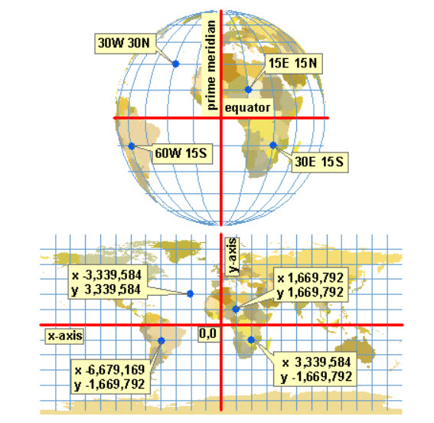
14
A Projected Coordinate System consists of
Geographic Coordinate System
Projection Algorithm
Linear Unit
Parameters that center the system on a certain location
© Jochen Albrecht. All rights reserved. This content is excluded from our Creative Commons license. For more information, see https://ocw.mit.edu/help/faq-fair-use/
Introduction > Projections > Metadata > Processing Tools > Exercise
Introduction » Map Projections » Metadata » Processing Tools » Exercise
Analysis >> Projections >> Metadata >> Processing Tools >> Exercise
Notes:
A projection is part of a Projected Coordinate System. A projected coordinate system also includes a geographic coordinate system, a linear unit, and parameters that can be used to center the coordinate system on different parts of the world. A projected coordinate system is more accurate when it is centered over a location and thousands of systems have been developed for different parts of the world. For example, each state has several projected coordinate systems that are idealized for that state.
Image from: http://www.geography.hunter.cuny.edu/~jochen/gtech361/lectures/lecture04/concepts/Map%20coordinate%20systems/Projection%20parameters.htm

Slide 15
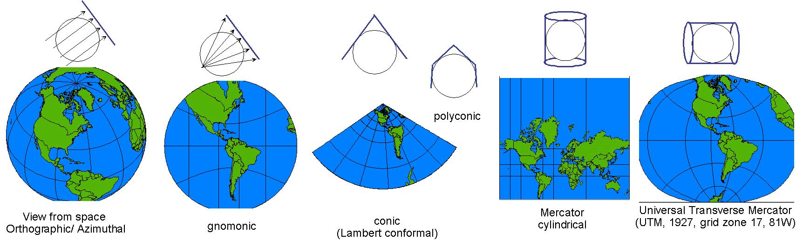
15
There are many different types of projections. Each have certain strengths and limitations in the following types of distortions: shape, area, distance, direction
© source unknown. All rights reserved. This content is excluded from our Creative Commons license. For more information, see https://ocw.mit.edu/help/faq-fair-use/
Introduction > Projections > Metadata > Processing Tools > Exercise
Introduction » Map Projections » Metadata » Processing Tools » Exercise
Analysis >> Projections >> Metadata >> Processing Tools >> Exercise
Notes:
Representing the earth's surface in two dimensions causes distortion in the shape, area, distance, or direction of the data. (as shown in the previous orange example)
When creating a map, you will want to think about which of the distortions you want to minimize and choose an appropriate projection.

Slide 16
Coordinate Systems Characteristics
16
Geographic
Projected
3D spherical/spheroidal surface defines locations
Units: degrees (angular)
Lengths, angles, and areas change with distance away from equator
2D flat/planar surface defines locations
Units: ft, m, miles, etc. (linear)
Lengths, angles, and areas constant across the two dimensions
Introduction » Map Projections » Metadata » Processing Tools » Exercise

Slide 17
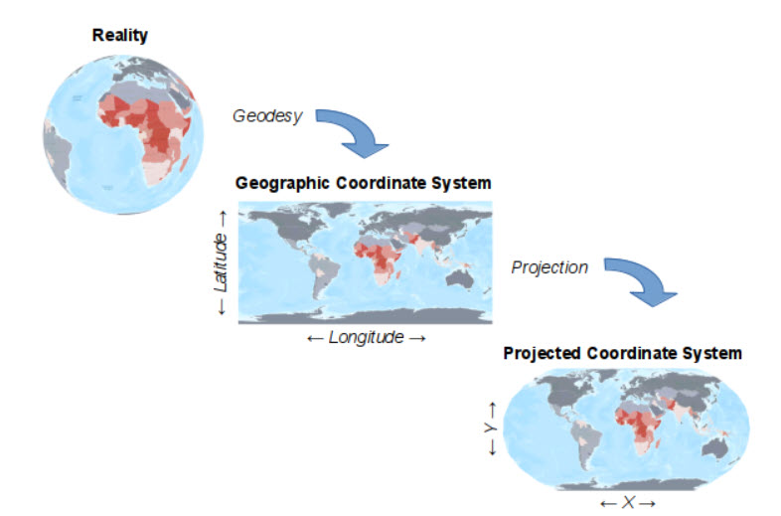
Coordinate Systems Summary
17
Data often start in a geographic coordinate system.
They are projected into a projected coordinate system.
The projection depends on the data location and analyses
Image © Michael Minn. All rights reserved. This content is excluded from our Creative Commons license. For more information, see https://ocw.mit.edu/help/faq-fair-use/
Introduction » Map Projections » Metadata » Processing Tools » Exercise
Notes:
To summarize, a datum is a representation of the earth’s surface and is part of a geographic coordinate system. A projection algorithm can be applied to that system to create a projected coordinate system for a specific location.

Slide 18
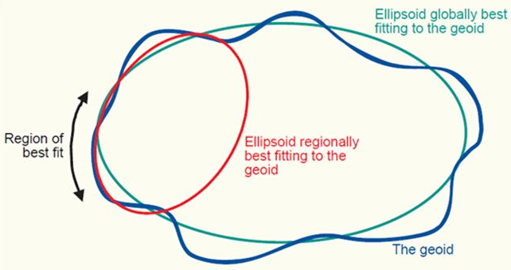
Commonly Encountered Systems
18
Geographic Coordinate System
NAD83 (North American Datum) – best fitting ellipsoid for North America
WGS1984 (World Geodetic System) – best fitting ellipsoid for the globe/world
Courtesy of NOAA. Image is in the public domain.
Introduction » Map Projections » Metadata » Processing Tools » Exercise
Notes:
In the picture above the larger turquoise ellipse fits well for the entire earth/geoid, but not for a smaller region. The red ellipse is a better fit in this case.
Two commonly used geographic coordinate systems are NAD83, which is the best fit (has the least distortion) for North American, and WGS84, which is the best fit for the entire world.
Source: https://slideplayer.com/slide/220638/
Alternative (very informative source): https://www.ngs.noaa.gov/web/science_edu/presentations_library/files/spcs2022_njspls_2019.pdf

Slide 19
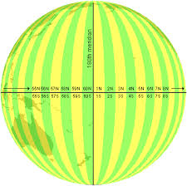
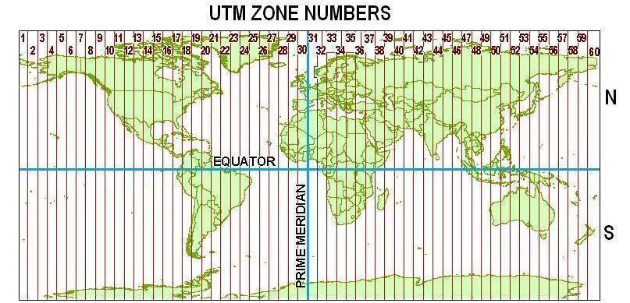
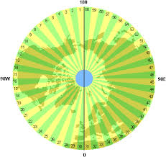
Commonly Encountered Systems
19
Projected Coordinate System
UTM (Universal Transverse Mercator) – often best for large regions
Courtesy of the National Geospatial-Intelligence Agency. Image is in the public domain.
© Jochen Albrecht. All rights reserved. This content is excluded from our Creative Commons license. For more information, see https://ocw.mit.edu/help/faq-fair-use/
Introduction » Map Projections » Metadata » Processing Tools » Exercise
Notes:
As mentioned previously, geographic coordinate systems can be “projected” (aka “flattened”) so that they appear less distorted on the screen and use a linear unit of measurement (meters, feet vs. decimal degrees). UTM is a common projected coordinate system for the world. It divides the earth into vertical zones. You would choose the zone that is appropriate for the location of your data in order to minimize distortions.
Sources: https://earth-info.nga.mil/GandG/coordsys/grids/utm.html & http://www.geo.hunter.cuny.edu/~jochen/GTECH201/Lectures/Lec6concepts/Map%20coordinate%20systems/UTM%20and%20UPS.htm

Slide 20
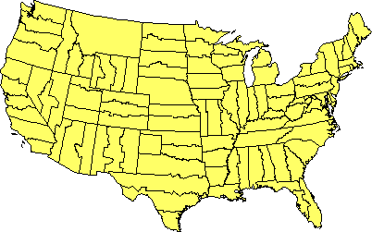
Commonly Encountered Systems
20
Projected Coordinate System
USA State Plane Systems – have been optimized per state, see updates here.
Introduction » Map Projections » Metadata » Processing Tools » Exercise
Notes:
There are specific projected coordinate systems for each state (and sometimes parts of a state) that minimize distortion in that area. The state plane system is used in the United States.
Sources: https://earth-info.nga.mil/GandG/coordsys/grids/utm.html & http://www.geo.hunter.cuny.edu/~jochen/GTECH201/Lectures/Lec6concepts/Map%20coordinate%20systems/UTM%20and%20UPS.htm

Slide 21
Tips on selecting a Projected Coordinate System
21
Based on your project’s analyses:
Preserve area with equal-area projections
Preserve shape with conformal projections
Preserve direction with azimuthal projections
Preserve distance with equidistant projections
Other projections compromise on the distortions
(Usually you stick with one, but can re-project)
Introduction » Map Projections » Metadata » Processing Tools » Exercise
Notes:
If you are transforming data from a geographic coordinate system into a projected one, you will need to choose the appropriate projected coordinate system. First, think about the analyses you will be doing. Which types of distortion would you want to minimize? For example, if you will be calculating the area of building you would want to choose a projected coordinate system that preserves area.
Source: http://www.geo.hunter.cuny.edu/~jochen/gtech201/lectures/lec6concepts/map%20coordinate%20systems/how%20to%20choose%20a%20projection.htm
Additional Sources:
https://eipd.dcs.wisc.edu/for-credit/GIS-cert/summer2017/geog370_m1/lesson_4.html
https://ihatecoordinatesystems.com/

Slide 22
Tips on selecting a Projected Coordinate System
22
Based on your project’s location:
Size
Locally, the US has ‘state plane systems’
Regionally, UTM is often a good option
World, World Mercator (EPSG: 3857)
Region
To map tropical regions, use a cylindrical projection
To map middle latitudes, use a conic projection
To map a polar region, use an azimuthal projection
Introduction » Map Projections » Metadata » Processing Tools » Exercise
Notes:
Next consider the region in which you are working and the size of your area of analysis. Some projected coordinate systems are designed for very small areas and some for large ones. There are systems for every part of the world.
Source: http://www.geo.hunter.cuny.edu/~jochen/gtech201/lectures/lec6concepts/map%20coordinate%20systems/how%20to%20choose%20a%20projection.htm

Slide 23
MAP Projections: How do you know the Coordinate system of your data?
23
Introduction > Projections > Metadata > Processing Tools > Exercise
Introduction » Map Projections » Metadata » Processing Tools » Exercise
Analysis >> Projections >> Metadata >> Processing Tools >> Exercise

Slide 24
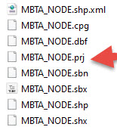
24
Option 1: Look for a .prj (projection) file within the files that make up the “shapefile” and then…
Introduction > Projections > Metadata > Processing Tools > Exercise
Introduction » Map Projections » Metadata » Processing Tools » Exercise
Analysis >> Projections >> Metadata >> Processing Tools >> Exercise
Notes:
When you download data from the web or are given it from a colleague, how do you know if it has a coordinate system? For shapefiles, look for a .prj file.

Slide 25
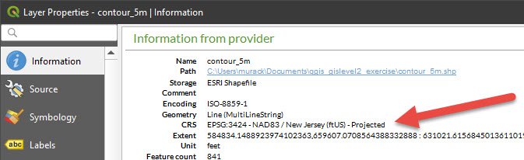
25
Option 1 continued: Open the file in QGIS or ArcGIS and examine the data layer information.
Note: ESRI products (ArcGIS Desktop and ArcGIS Pro) refer to geographic & projected coordinate systems with names while QGIS uses EPSG codes: NAD 1983 StatePlane New Jersey FIPS 2900 (US Feet) versus EPSG: 3424
Introduction > Projections > Metadata > Processing Tools > Exercise
Introduction » Map Projections » Metadata » Processing Tools » Exercise
Analysis >> Projections >> Metadata >> Processing Tools >> Exercise
Notes:
Once you have confirmed there is a .prj file, how do you know what the projection is? You can view coordinate system information for each data layer in GIS software.
When using QGIS, you will always see an EPSG code for each coordinate reference system. This is a unique number that is assigned to each system.
It’s useful to use the EPSG code when searching for a projection to make sure you are selecting the one you want. Often projections have similar names and it’s easy to select one the incorrect one if you are just looking by name.

Slide 26
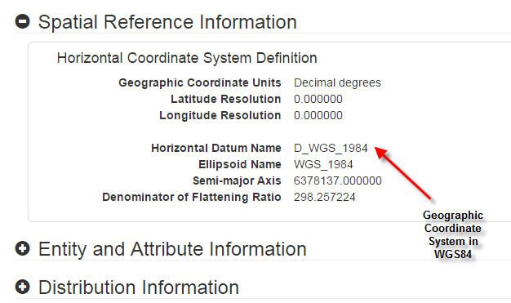
26
Option 2: Consult the metadata
Introduction > Projections > Metadata > Processing Tools > Exercise
Introduction » Map Projections » Metadata » Processing Tools » Exercise
Analysis >> Projections >> Metadata >> Processing Tools >> Exercise
Notes:
If you downloaded data from a website, you can often find metadata that lists the map projection.
You can find metadata:
-Downloaded with your data layers
-On the website where you got your data
-Sometimes you may need to contact the data provider to get metadata
Most commonly used metadata formats are html/xml, text files, or in a table format, such as excel or csv.

Slide 27
Exercise 1: Coordinate Systems
27
Goals
Learn how to transform a coordinate system in GIS software
Steps
Open either the QGIS or ArcGIS Pro.
You will now choose a breakout rooms and be guided through the first exercise.
Introduction » Map Projections » Metadata » Processing Tools » Exercise

Slide 28
Processing Tools: OVERVIEW
28
Introduction > Projections > Metadata > Processing Tools > Exercise
Introduction » Map Projections » Metadata » Processing Tools » Exercise
Analysis >> Projections >> Metadata >> Processing Tools >> Exercise

Slide 29
Use processing tools to:
29
“capture, store, check, integrate, manipulate, analyze and display
geospatial data”
Introduction > Projections > Metadata > Processing Tools > Exercise
Introduction » Maps & Data » Making Maps » Software » Exercise
Introduction » Map Projections » Metadata » Processing Tools » Exercise
Notes:
GIS software includes hundreds of tools you can use to perform different processes on your data.

Slide 30
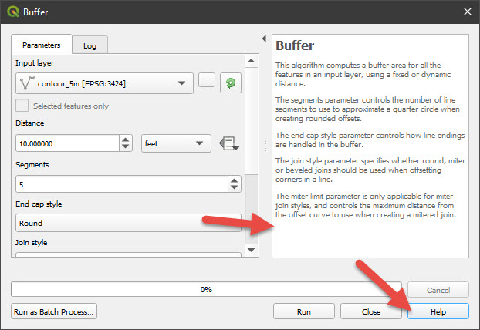
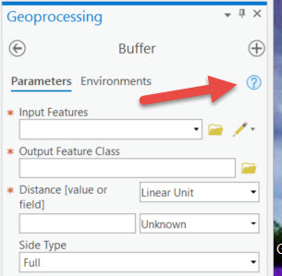
Tool considerations
30
Read the tool help resource to understand how it works and determine if it is appropriate for your data.
The accuracy of the input data determines the accuracy of the results.
Introduction > Projections > Metadata > Processing Tools > Exercise
Introduction » Map Projections » Metadata » Processing Tools » Exercise
Analysis >> Projections >> Metadata >> Processing Tools >> Exercise
Notes:
Both QGIS and ArcGIS Pro tools include links to help documentation. Read this to determine how the tool works, the required input fields, and any other considerations.
Certain tools may required data in certain formats or projections. There may also be other assumptions about the input data.

Slide 31
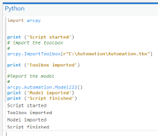
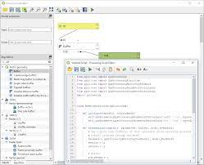
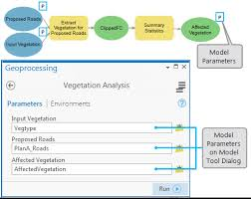
Batch tools
31
Record tools, inputs, and parameters used. Export this information as python code, if possible, so results can be replicated.
This is the focus of the GIS Level 3 workshop
QGIS: Graphical Modeler & Python
ArcGIS Pro: Model Builder & Python
Introduction > Projections > Metadata > Processing Tools > Exercise
Introduction » Map Projections » Metadata » Processing Tools » Exercise
Analysis >> Projections >> Metadata >> Processing Tools >> Exercise
Notes:
You will often use several tools in a row to process your data. Make sure to keep a record of the tools you use, their inputs, parameters, and the names of the output files.
You can do this manually or use the Graphical Modeler in QGIS or the Model Builder in ArcGIS Pro. Drag and drop tools and inputs into these programs to visually see your workflow. You can also run all the tools multiple times using these programs and export your process a python code to share with others. If you are familiar with python you can use it to write code for your GIS analysis. Our GIS Level 3 workshop, which will likely be offered in January, covers using python with ArcGIS Pro.

Slide 32
Processing Tools: arCGIS Pro vS QGIS
32
Introduction > Projections > Metadata > Processing Tools > Exercise
Introduction » Map Projections » Metadata » Processing Tools » Exercise
Analysis >> Projections >> Metadata >> Processing Tools >> Exercise
Notes:
Now we will discuss the general way tools are set-up and run in both QGIS and ArcGIS Pro.

Slide 33
Analysis Tools
33
ArcGIS Pro (by ESRI)
QGIS
Can easily import all data types (raster, vector, tabular)
Full set of GIS functions & tools (depends on licensing level)
Comprehensive support (direct support from ESRI, access to online modules and tutorials, and documentation for every tool)
Can easily import all data types (raster, vector, tabular, & more)
Many available tools, but lacking some advanced analyses: network analysis, spatial statistics
Tools can be developed by anyone so performance & documentation can be inconsistent.
Support via forums, eg StackExchange
Both have similar interfaces
and many of the same analysis tools.
Introduction > Projections > Metadata > Processing Tools > Exercise
Introduction » Map Projections » Metadata » Processing Tools » Exercise
Notes:
For most uses, either software will work well so you may want to base your decision on your computer’s resources, how frequently you will need to use it, what you want to do, and the industry you plan to work in (or are currently working in).
Both softwares have many of the same tools, but you may find a tool in QGIS that is not in ArcGIS Pro and vice versa.

Slide 34
Processing Tools: arCGIS PRO
34
Introduction > Projections > Metadata > Processing Tools > Exercise
Introduction » Map Projections » Metadata » Processing Tools » Exercise
Analysis >> Projections >> Metadata >> Processing Tools >> Exercise

Slide 35
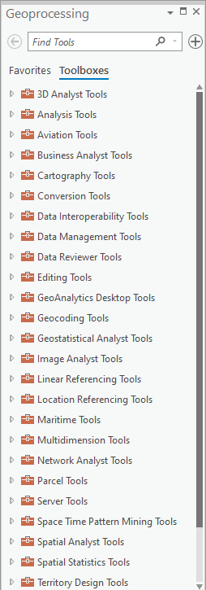
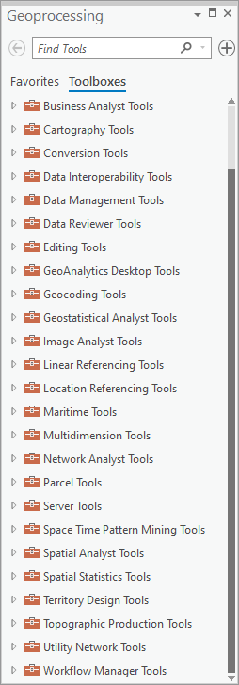
ArcGIS Pro Analysis Tools
35
ArcGIS Pro offers a variety of toolboxes that contain tools that work on certain types of data or perform specific types of analysis.
Introduction > Projections > Metadata > Processing Tools > Exercise
Introduction » Map Projections » Metadata » Processing Tools » Exercise
Analysis >> Projections >> Metadata >> Processing Tools >> Exercise
Notes:
ArcGIS Pro organizes tools into toolboxes.

Slide 36
ArcGIS Pro Extensions
36
Advanced Analysis
Data and Workflows
3D Analyst
Business Analyst
Geostatistical Analyst
Image Analyst
Network Analyst
Spatial Analyst
Data Interoperability
Data Reviewer
Indoors
LocateXT
Publisher
StreetMap Premium
Territory Design
Workflow Manager
Workflow Manager (Classic)
Used most often
Industry Focused
Aviation Airports & Charting
Defense Mapping
Maritime
Pipeline Referencing
Production Mapping
Roads and Highways
Introduction > Projections > Metadata > Processing Tools > Exercise
Introduction » Map Projections » Metadata » Processing Tools » Exercise
Analysis >> Projections >> Metadata >> Processing Tools >> Exercise
Notes:
Some of the more specialized tools require an extra license or an additional installation. All are available while you are at MIT and the most commonly used one are built into ArcGIS Pro.
If you run into a licensing error when trying to use these tools, email us and we can make sure the license is activated on your account.

Slide 37
Processing Tools: QGIS
37
Introduction > Projections > Metadata > Processing Tools > Exercise
Introduction » Map Projections » Metadata » Processing Tools » Exercise
Analysis >> Projections >> Metadata >> Processing Tools >> Exercise

Slide 38
QGIS Analysis Tools
38
QGIS offers vector analysis, raster analysis, sampling, geoprocessing, geometry, & database management tools.
Additional tools include:
Integrated GRASS tools with more than 400 modules.
Processing plugin, a powerful geospatial analysis framework to call native and third-party algorithms from QGIS, such as GDAL, SAGA, GRASS, R, etc.
Extensible plugin architecture, can extend QGIS functionality where libraries can be used to create your own plugins.
Introduction > Projections > Metadata > Processing Tools > Exercise
Introduction » Map Projections » Metadata » Processing Tools » Exercise
Analysis >> Projections >> Metadata >> Processing Tools >> Exercise
Notes:
QGIS has a similar set of tools, but they are organized in a different way. Additionally there are tools created by users.
QGIS tools are often built on other languages, such as GRASS or GDAL. While we aren’t familiar enough with these languages to provide help, it’s possible to run analysis directly through the, outside of QGIS, or use them to build your own QGIS tools.

Slide 39
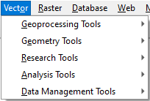
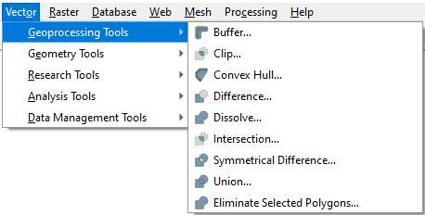
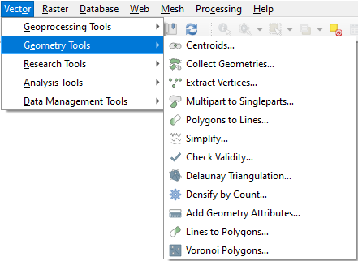
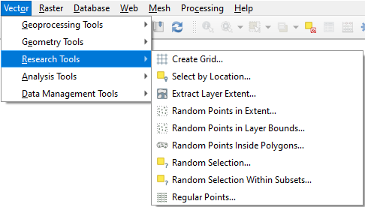
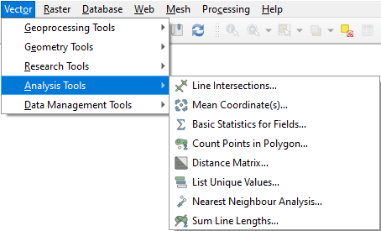
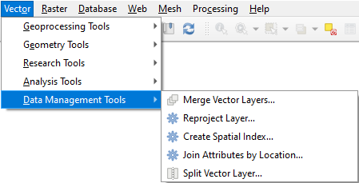
QGIS Vector Analysis Tools
39
Introduction > Projections > Metadata > Processing Tools > Exercise
Introduction » Map Projections » Metadata » Processing Tools » Exercise
Analysis >> Projections >> Metadata >> Processing Tools >> Exercise
Notes:
QGIS comes with a variety of tools that are grouped into those that work on Vector data and those that work on Raster data. Similar to ArcGIS Pro, you can see here that the vector tools are grouped into several categories.

Slide 40
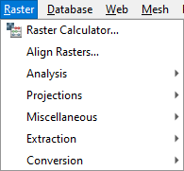
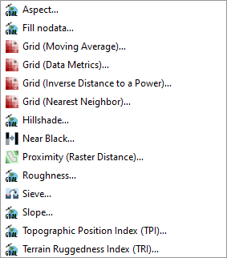

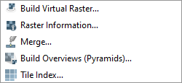

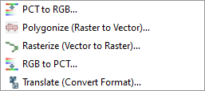
QGIS Raster Analysis Tools
40
Introduction > Projections > Metadata > Processing Tools > Exercise
Introduction » Map Projections » Metadata » Processing Tools » Exercise
Analysis >> Projections >> Metadata >> Processing Tools >> Exercise
Notes:
The Raster tools are organized in a similar way.

Slide 41
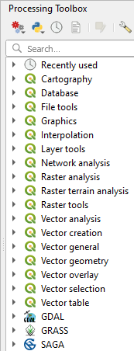
41
QGIS Processing Plugin
Processing plugin:
a powerful geospatial analysis framework to call native and third-party algorithms from QGIS, such as GDAL, GRASS, SAGA, GRASS, R, etc.
Introduction > Projections > Metadata > Processing Tools > Exercise
Introduction » Map Projections » Metadata » Processing Tools » Exercise
Analysis >> Projections >> Metadata >> Processing Tools >> Exercise
Notes:
In addition to what you find at the top menu, QGIS includes additional tools in the Processing Toolbox (again, similar to the toolbox in ArcGIS Pro).

Slide 42
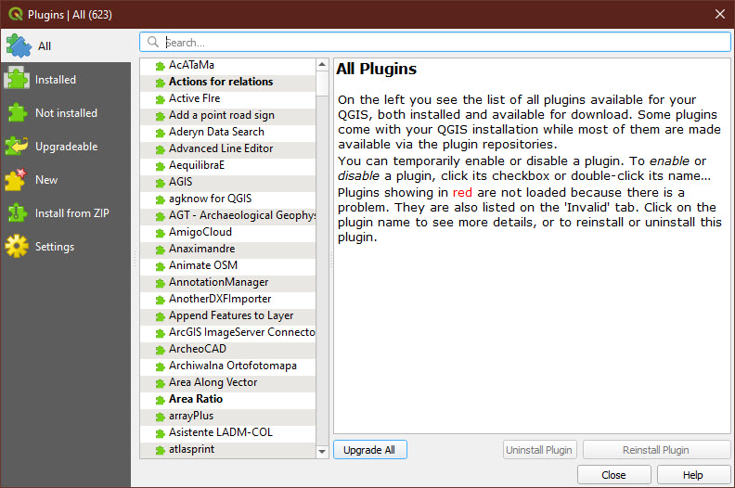
42
QGIS Plugin Repositories
add useful features to the software
are written by QGIS developers & other independent users
available through the Plugins menu
Introduction > Projections > Metadata > Processing Tools > Exercise
Introduction » Map Projections » Metadata » Processing Tools » Exercise
Analysis >> Projections >> Metadata >> Processing Tools >> Exercise
Notes:
Additionally there is a QGIS plugin repository where you can find additional tools created by users. Adding these to your QGIS may add additional toolbar menus or additional options under the existing menus.
To summarize:
ArcGIS Pro tools can be found in the toolbox, with some requiring an additional license. Some of the more popular tools display at the top menu ribbon. These tools are created by developers at ESRI, which created the software.
QGIS tools can be found in the toolbar menu, the processing toolbox, or as an additional plugin. These tools are created by a variety of QGIS users.
Googling is a great way to find out if a tool exists and where it is located in the software.

Slide 43
Vector Analysis
43
Introduction > Projections > Metadata > Processing Tools > Exercise
Introduction » Map Projections » Metadata » Processing Tools » Exercise
Analysis >> Projections >> Metadata >> Processing Tools >> Exercise

Slide 44
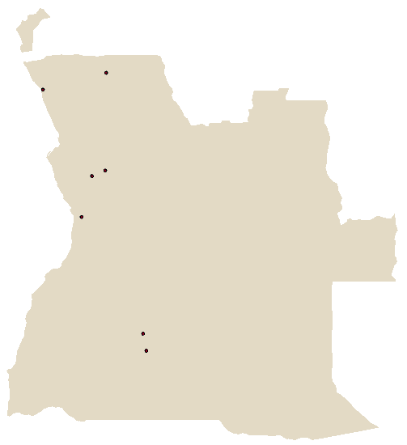
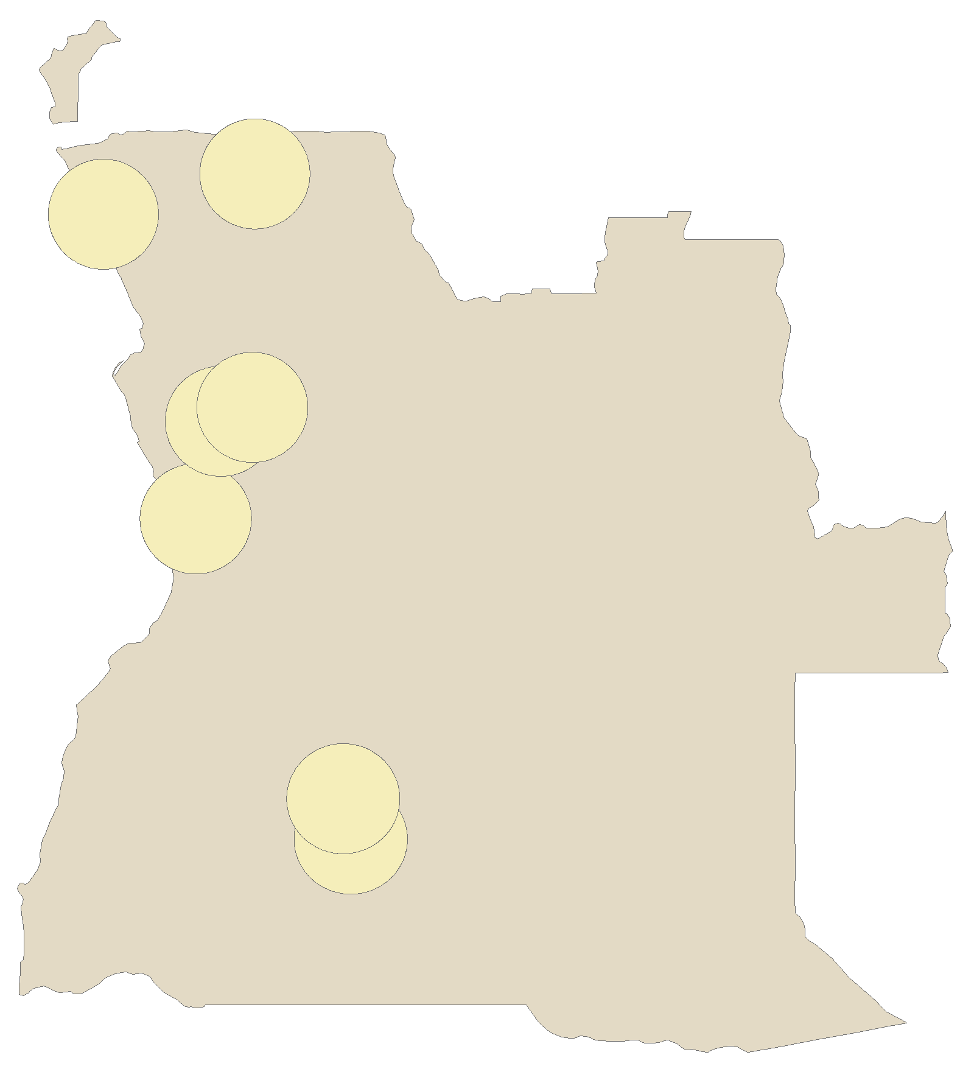
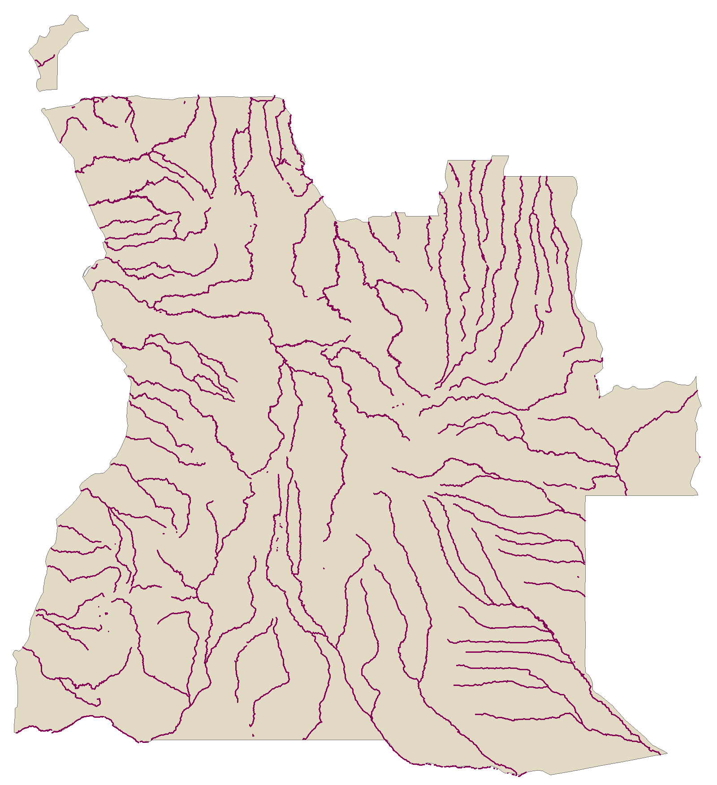
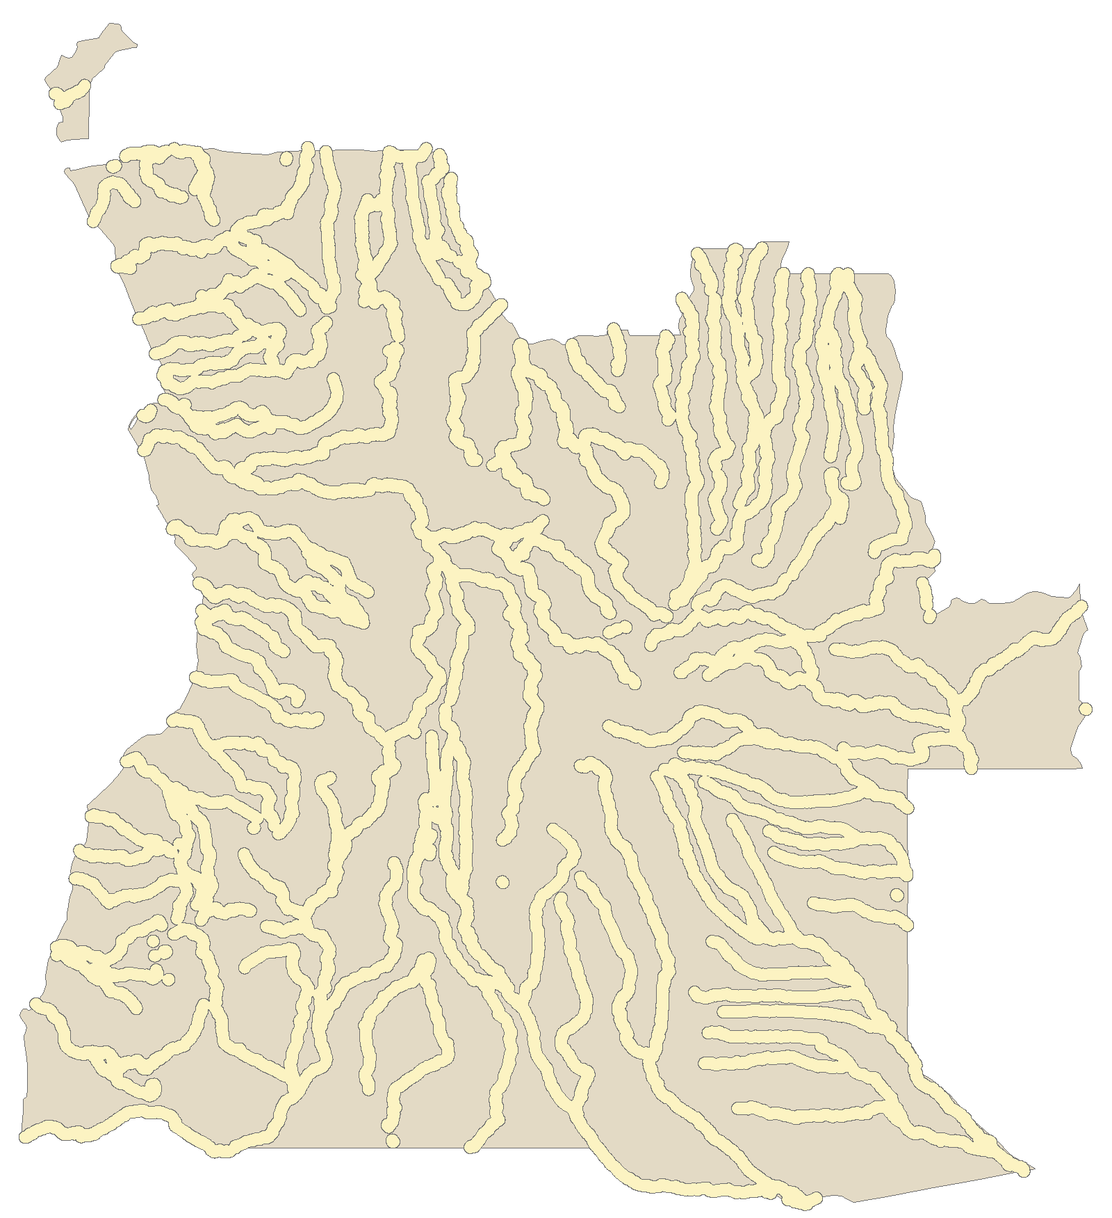
Buffer
44
Creates a polygon around a feature at given distance(s)
Where, the input feature can be a point, line, or polygon
Options to dissolve or create separate features
Examples:
50 miles around mines
5 miles around rivers
Introduction » Map Projections » Metadata » Processing Tools » Exercise
Introduction > Projections > Metadata > Processing Tools > Exercise
Analysis >> Projections >> Metadata >> Processing Tools >> Exercise
Notes:
The buffer tool creates a polygon surrounding a feature at a distance you choose.

Slide 45
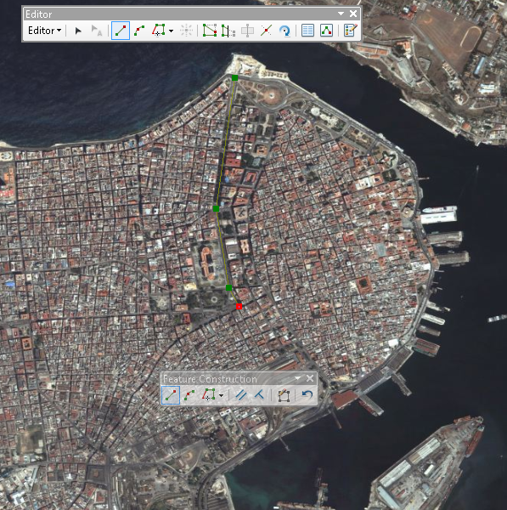
Create and Edit Features
45
New shapefiles can be created from scratch
Features can be edited or created using the editor toolbar in Arc or QGIS
Example: creating a major road layer (green) for Havana, Cuba based on satellite imagery
Introduction » Map Projections » Metadata » Processing Tools » Exercise
Introduction > Projections > Metadata > Processing Tools > Exercise
Analysis >> Projections >> Metadata >> Processing Tools >> Exercise
Notes:
Editing tools are used to create new data, often times from satellite imagery or a scanned map. For example you can extract features or trace data from an image.

Slide 46


Clip (Vectors)
46
Use one layer’s extent to clip down the features of another layer
Input layer can be points, lines, or polygons, but the clip layer must be a polygon
Example: European railroad layer clipped to France layer
Introduction > Projections > Metadata > Processing Tools > Exercise
Introduction » Map Projections » Metadata » Processing Tools » Exercise
Analysis >> Projections >> Metadata >> Processing Tools >> Automation >> Exercise
Notes:
The clip tool is like a cookie cutter and can be used to subset data. You often don’t need all the data in a file you have downloaded and extracting only what you need will speed up processing and loading time.

Slide 47
Exercise 2: Vector Analysis
47
Goals
Learn how to access, interpret, and troubleshoot analysis tools in GIS software
Steps
You will go back into your breakout room and be guided through the second exercise.
Introduction > Projections > Metadata > Processing Tools > Exercise
Introduction » Map Projections » Metadata » Processing Tools » Exercise

Slide 48
Surface Analysis
48
Introduction > Projections > Metadata > Processing Tools > Exercise
Analysis >> Projections >> Metadata >> Processing Tools >> Exercise
Notes:
There separate tools to be used with vectors vs. rasters because the file formats are different.

Slide 49


Interpolation
49
Create a continuous surface from points.
© Esri. All rights reserved. This content is excluded from our Creative Commons license. For more information, see https://ocw.mit.edu/help/faq-fair-use/
Notes:
Interpolation tools create a continuous raster surface from individual points on a map. In these examples, the elevation surface is interpolated from individual elevation point values and the ozone level for California is interpolated from values at individual monitoring stations.
There are a variety of algorithms to choose from in order to create this surface.

Slide 50

Extract by Mask (Pro)/Clip Raster (QGIS)
50
Only cells/pixels within a boundary are retained in output
Input must be a raster but the clip feature can be anything:
points, lines, polygons, or another raster (anything with area)
Image © Esri. All rights reserved. This content is excluded from our Creative Commons license. For more information, see https://ocw.mit.edu/help/faq-fair-use/
Introduction > Projections > Metadata > Processing Tools > Exercise
Notes:
Extract by Mask is what you would use to clip a raster. Again, extracting only what you need decreases file sizes.

Slide 51

Contour
51
Creates contour line layer from raster surface.
Note: they will not extend past the spatial extent of the raster nor in areas with no data
Image © Esri. All rights reserved. This content is excluded from our Creative Commons license. For more information, see https://ocw.mit.edu/help/faq-fair-use/
Introduction > Projections > Metadata > Processing Tools > Exercise
Notes:
Contour lines can be produced from elevation rasters called DEMs (digital elevation model).

Slide 52

Slope
52
For each cell, the maximum rate of change in value from that cell to its neighbors is calculated.
The output slope raster can be calculated in two types of units, degrees or percent (percent rise).
Image © Esri. All rights reserved. This content is excluded from our Creative Commons license. For more information, see https://ocw.mit.edu/help/faq-fair-use/
Introduction > Projections > Metadata > Processing Tools > Exercise
Notes:
Slope can also be calculated from elevation rasters, and used as inputs in other tools.

Slide 53

Zonal Statistics (…as Table)
53
Zonal Statistics - calculates one statistic (e.g. mean, max, min, stdev, range) from an input raster over a zone/area and produces a new layer.
Zonal Statistics as Table (Pro)/Zonal Histogram (QGIS) - calculates multiple statistics but produces a table (which can be joined back to geometry, or exported to statistical software)
Image © Esri. All rights reserved. This content is excluded from our Creative Commons license. For more information, see https://ocw.mit.edu/help/faq-fair-use/
Introduction > Projections > Metadata > Processing Tools > Exercise
Notes:
Zonal statistics can be used to summarize a raster by different zones/cookie cutter areas. For example, if you have a raster where each pixel is a different land use, you could overlay town boundaries to find the predominant land use in each town.

Slide 54
Surface analysis tools: also are used to…
54
Analyze Patterns
Analyze Terrain
Generalize
Conduct hydrological analysis
Manage Data
Summarize Data
Use Proximity
Introduction > Projections > Metadata > Processing Tools > Exercise
Notes:
There are a lot of additional tools that fall under the following categories.

Slide 55
Exercise 3: Raster tools
55
Goals
Learn how to access raster tools
Steps
You will go back into your breakout room and be guided through the third exercise.

Slide 56
Spatial Statistics
56
Introduction > Projections > Metadata > Processing Tools > Exercise
Introduction » Map Projections » Metadata » Processing Tools » Exercise
Analysis >> Projections >> Metadata >> Processing Tools >> Exercise

Slide 57
What are spatial statistics?
57
methods for analyzing spatial distributions, patterns, processes, and relationships
they incorporate space (proximity, area, connectivity, and/or other spatial relationships) directly into their mathematics
Introduction > Projections > Metadata > Processing Tools > Exercise
Analysis >> Projections >> Metadata >> Processing Tools >> Exercise

Slide 58


Spatial autocorrelation (Moran’s I)
58
Measures the patterns of attribute values associated with features (ex. median home value, percent female, etc.).
Compares the value of the feature to that of its neighbors and the entire study area.
Indicates clusters of high or low values (positive I value) or outliers (negative I value).
Use Moran’s I to test visual patterns for statistical significance.
© sources unknown. All rights reserved. This content is excluded from our Creative Commons license. For more information, see https://ocw.mit.edu/help/faq-fair-use/
Introduction > Projections > Metadata > Processing Tools > Exercise
Analysis >> Projections >> Metadata >> Processing Tools >> Exercise
Notes:
If you see what appear to be clusters of similar data or outliers in your choropleth map, you can use spatial statistics tools to analyze the values of the data to see if there is a statistically significant pattern.
Spatial autocorrelation analyzes the values in your attribute table, comparing the value of each feature (i.e. each row) to that of neighboring features and the entire study area to find clusters of low or high values.

Slide 59



Neighbors: Distance Models
59
Inverse distance: all features influence all other features, but the closer something is, the more influence it has
Distance band: features outside a specified distance do not influence the features within the area
Zone of indifference: combines inverse distance and distance band
Introduction > Projections > Metadata > Processing Tools > Exercise
Analysis >> Projections >> Metadata >> Processing Tools >> Exercise
Notes:
The results of spatial autocorrelation are dependent on how the neighborhood is defined. In GIS software you create what is called a “weights” file to define your neighborhoods. This is used as input when running a spatial statistics tool.
Here are some examples of how you may define a neighborhood based on distance.

Slide 60


Neighbors: Adjacency Models
60
K Nearest Neighbors: a specified number of neighboring features are included in calculations
Polygon Contiguity: polygons that share an edge or node influence each other
Spatial weights: specified by user (ex. Travel times or distances)
Introduction > Projections > Metadata > Processing Tools > Exercise
Analysis >> Projections >> Metadata >> Processing Tools >> Exercise
Notes:
You can also define neighbors based on adjacency or by creating your own weights file.

Slide 61


Spatial autocorrelation (Moran’s I)
61
© sources unknown. All rights reserved. This content is excluded from our Creative Commons license. For more information, see https://ocw.mit.edu/help/faq-fair-use/
Introduction > Projections > Metadata > Processing Tools > Exercise
Analysis >> Projections >> Metadata >> Processing Tools >> Exercise
Notes:
One method use to determine clusters of similar values is called Moran’s I.
It can be used with points (you would want to choose distance neighborhood model) or polygons, although it tends to be more widely used with polygon data.
In both examples the output of this tools are additional data layers indicating where there are clusters of high values or low values and where there are places with outliers (a low value surrounded by high values or a high value surrounded by low values).

Slide 62
Other spatial statistics tools
62
Analyzing patterns
Nearest neighbor, Ripley’s K
Geographic distributions
mean, median, directional mean
Regression
Geographic, Ordinary Least Squares (OLS)
Introduction > Projections > Metadata > Processing Tools > Exercise
Analysis >> Projections >> Metadata >> Processing Tools >> Exercise
Notes:
There are other tools that look at the patterns created by the location of features (rather than the value of the attributes) and the location of points. You can also do regression.
QGIS has a more limited set of spatial statistics tools. There is another free, open-source program called Geoda, which can be used to supplement the tools found in QGIS. This will be used in the final exercise.

Slide 63
Exercise 4: Spatial Statistics
63
Goals
Learn how to access specialized analysis tools
Understand the results of a basic spatial autocorrelation.
Steps
You will go back into your breakout room and be guided through the fourth exercise.

Slide 64
Distance & Network Analysis
64
Introduction > Projections > Metadata > Processing Tools > Exercise
Analysis >> Projections >> Metadata >> Processing Tools >> Exercise

Slide 65

Distance in a GIS
65
© Google. All rights reserved. This content is excluded from our Creative Commons license. For more information, see https://ocw.mit.edu/help/faq-fair-use/
Introduction > Projections > Metadata > Processing Tools > Exercise
Analysis >> Projections >> Metadata >> Processing Tools >> Exercise
Notes:
Here we can see that Google maps a route from Back Bay in Boston to the GIS and Data Lab at 77 Massachusetts Avenue in Cambridge.
Google appropriately picks roads that likely have sidewalks and routes you along those roads. It doesn’t assume that you have a boat to cross the river on.

Slide 66

Distance functions in GIS
66
Without regard to any network, over the surface of the earth vs on a road network
© Google. All rights reserved. This content is excluded from our Creative Commons license. For more information, see https://ocw.mit.edu/help/faq-fair-use/
Introduction > Projections > Metadata > Processing Tools > Exercise
Analysis >> Projections >> Metadata >> Processing Tools >> Exercise
Notes:
There are two main types of distance functions that exist in GIS: tools that use a line network (roads, trains, etc.) and those that use a straight-line distance.
In the former, your paths have to remain on part of the network. You can see in the example above the point in Back Bay. Using the road network, the distance from the point to any areas 1 mile away is shown in brown. Red shows 1 mile from the point not using the road network. It’s clear that the distance traveled over road networks limits your actual distance from the point, especially when there are significant barriers to travel, like the Charles River.
The distance without regard to networks was calculated using the Buffer tool. The buffer tool requires only a point to calculate distance.
The distance with regard to networks was calculated with the Network Analysis extension tool called Service Area. The Service Area tool requires a road network to find distances. There are some basic network analysis tools in QGIS, but more extensive ones in ArcGIS Pro.

Slide 67

Network Analysis Tools
67
Routing
Service Areas
Closest facility
OD Cost Matrix
Vehicle Routing Problem
Location-Allocation
(Only for ArcGIS Products)
Introduction > Projections > Metadata > Processing Tools > Exercise
Analysis >> Projections >> Metadata >> Processing Tools >> Exercise
Notes:
Network analyst tools are often used to vehicle routing or anytime you want to calculate something using a road (or other transportation) network.

Slide 68
Take-Home Exercise
68
Introduction > Projections > Metadata > Processing Tools > Exercise
Analysis >> Projections >> Metadata >> Processing Tools >> Exercise

Slide 69
Take-home Exercise overview
69
Continuing with the data from GIS Level 1, explore where you may build a mixed use facility in Jersey City.
This exercise will take into account the following factors:
Clustering of unemployment
Distance to transportation
Terrain
Introduction > Projections > Metadata > Processing Tools > Exercise
Analysis >> Projections >> Metadata >> Processing Tools >> Exercise

Slide 70
MIT OpenCourseWare
https://ocw.mit.edu
RES.STR-001 Geographic Information System (GIS) Tutorial
IAP 2022
For information about citing these materials or our Terms of Use, visit: https://ocw.mit.edu/terms

